Slide 1
Knowledge Representation and Reasoning Part-1

Slide 2
Knowledge is the collection of facts, information, and skills acquired through experience or training or education.
It is the theoretical or practical understanding of a subject/topic.
Reasoning means processing of knowledge.
Intelligence is the ability to use the knowledge.

Slide 3
Humans are capable to understand, and interpret the knowledge.
As per their knowledge, they perform various actions in the real world.
How machines can do all these things?
It comes under knowledge representation and reasoning.
It is part of AI which concerned with AI agents thinking and how thinking
contributes to their intelligent behavior.

Slide 4
Knowledge representation is not just storing data into some database, but it also enables an intelligent agent to learn from that knowledge and experiences so that it can behave intelligently like a human.
Knowledge representation can use this knowledge to solve the real world problems like diagnosis a medical condition or communicating with humans in natural language.

Slide 5
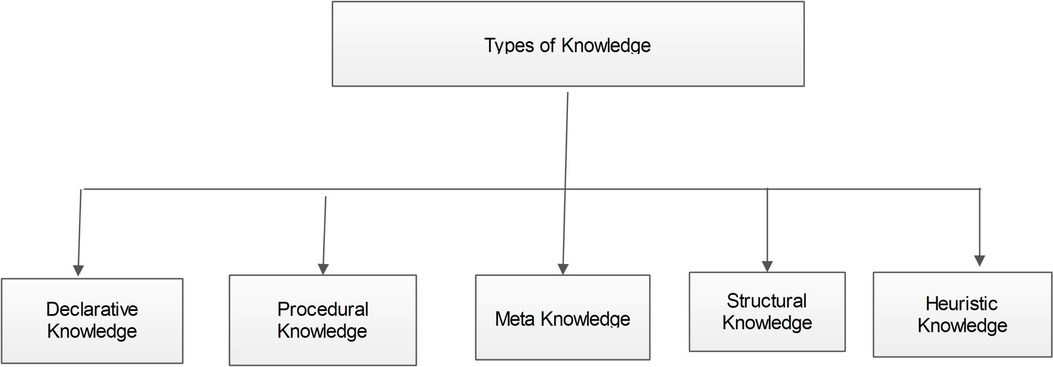

Slide 6
1. Declarative Knowledge:
Declarative knowledge is to know about something like concepts, facts, and
objects.
It is also called descriptive knowledge and expressed in declarative sentences.
It is static in nature.
For example: New Delhi is the capital of India.

Slide 7
2. Procedural Knowledge
Procedural knowledge involves knowing how to do something.
It can be directly applied to any task.
It includes rules, strategies, procedures, agendas, etc.
It is process-oriented in nature
For example- riding a bicycle. When someone was teaching you how to ride a bicycle, no matter what they said, you probably struggled to grasp it until you’d actually done it a few times. Once you figured it out, it quickly became implicit knowledge. That is, the type of knowledge that is hard to explain as it is subconsciously stored in your mind.

Slide 8
3. Meta-knowledge:
Knowledge about the knowledge is called Meta-knowledge.
It is used to describe things such as tags, models and taxonomies that describe knowledge.
For example: bibliography

Slide 9
4. Heuristic knowledge:
Heuristic knowledge is representing knowledge of some experts in a field or subject.
Heuristic knowledge is rules of thumb based on previous experiences,
awareness of approaches, and which are good to work but not guaranteed.

Slide 10
5. Structural knowledge:
Structural knowledge is basic knowledge to problem-solving.
It describes relationships between various concepts such as kind of, part of, and
grouping of something.
It describes the relationship that exists between concepts and objects.

Slide 11
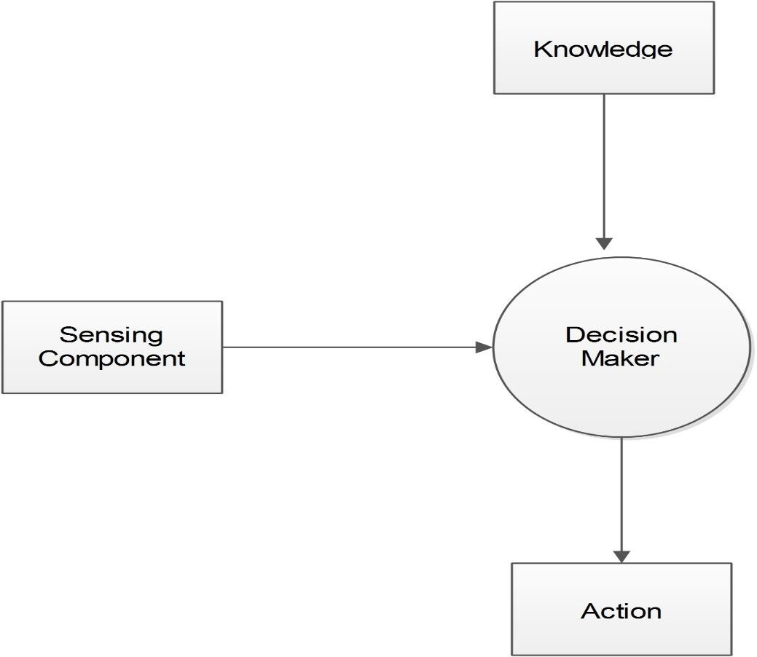
Relationship between Knowledge and Intelligence:
There maker
is one decision
which act by
sensing the environment as well as using its knowledge.
If the knowledge part will
not present then, it cannot display intelligent behavior.
So for
any intelligent we need
system,
knowledge.

Slide 12
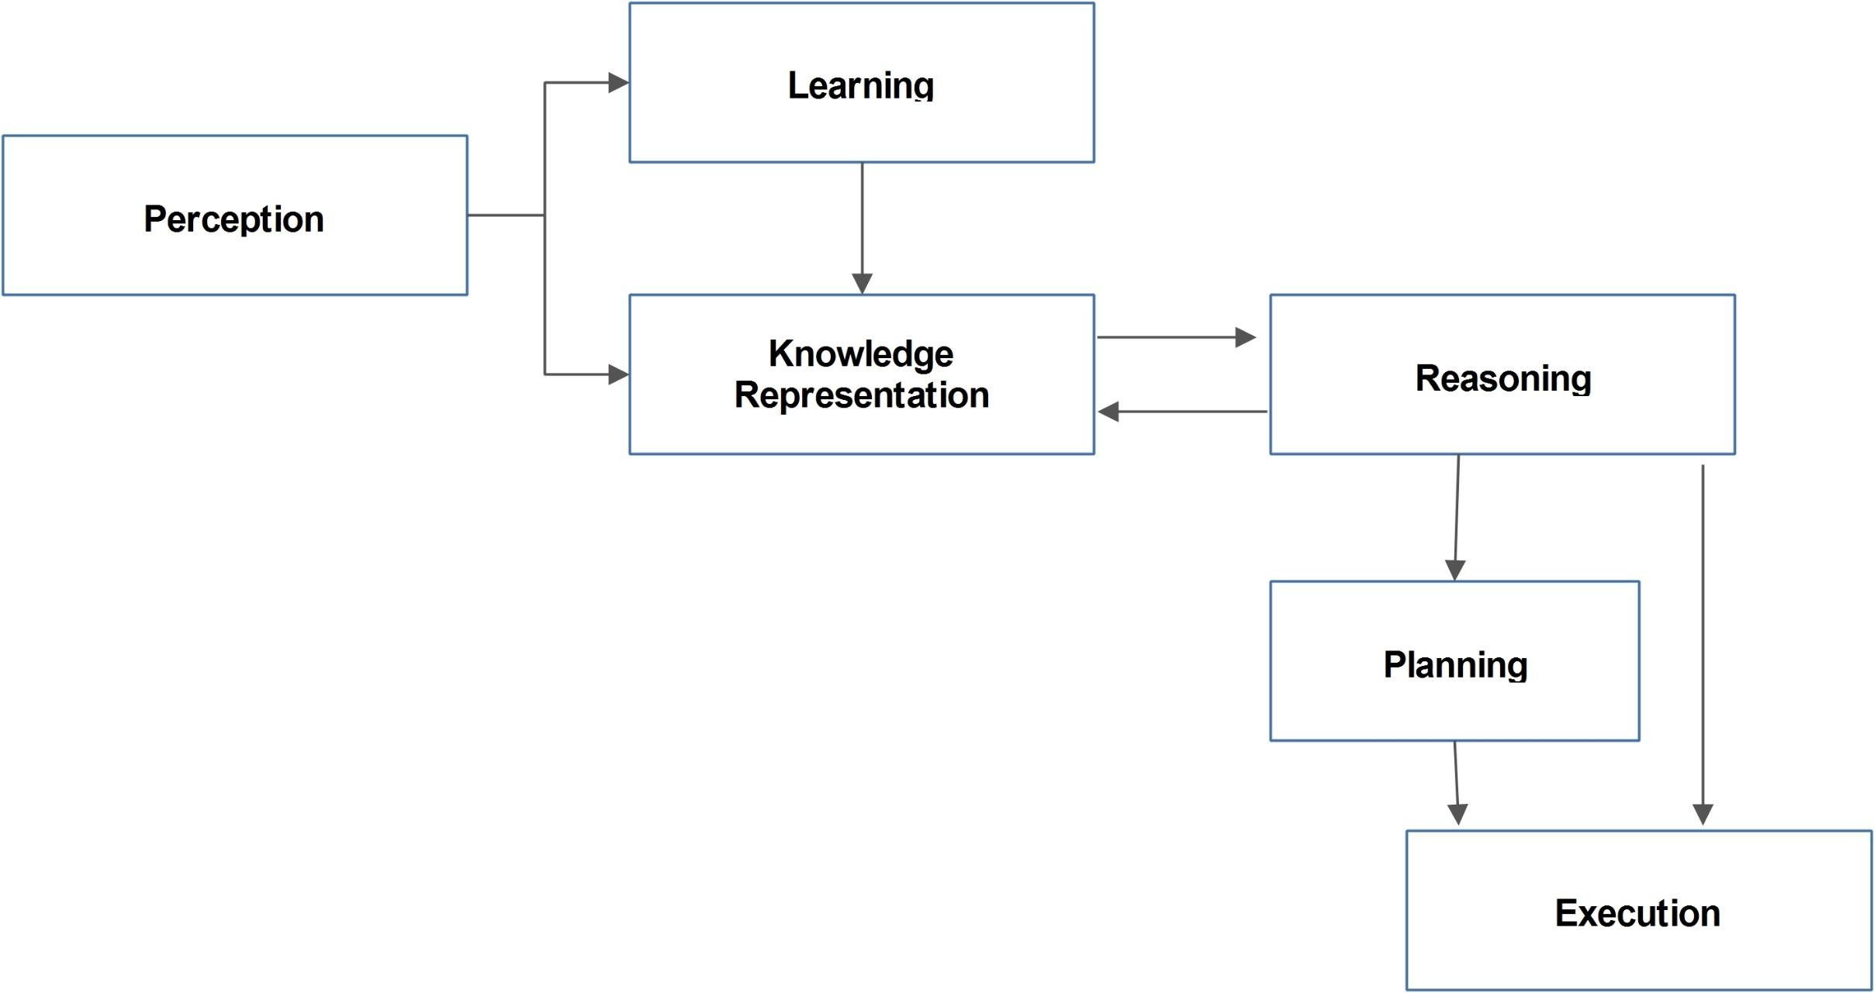
Cycle of knowledge
Perception component: Using this, AI agent retrieves information from its environment. It can be visual, audio or another form of sensory input.
The learning component is responsible for learning from data
captured by Perception comportment.
knowledge representation and Reasoning: These components are involved in showing the intelligence in machine-like humans. These two components are independent with each other but also coupled together.
The planning and execution depend on analysis of Knowledge representation and reasoning.

Slide 13
Approaches of Knowledge Representation
Logical Representation
Semantic Network Representation
Frame Representation
Production Rules

Slide 14
1. Logical Representation: It is a language type representation with some definite rules which deals with the propositions and has no ambiguity. It represents a conclusion based on various conditions

Slide 15
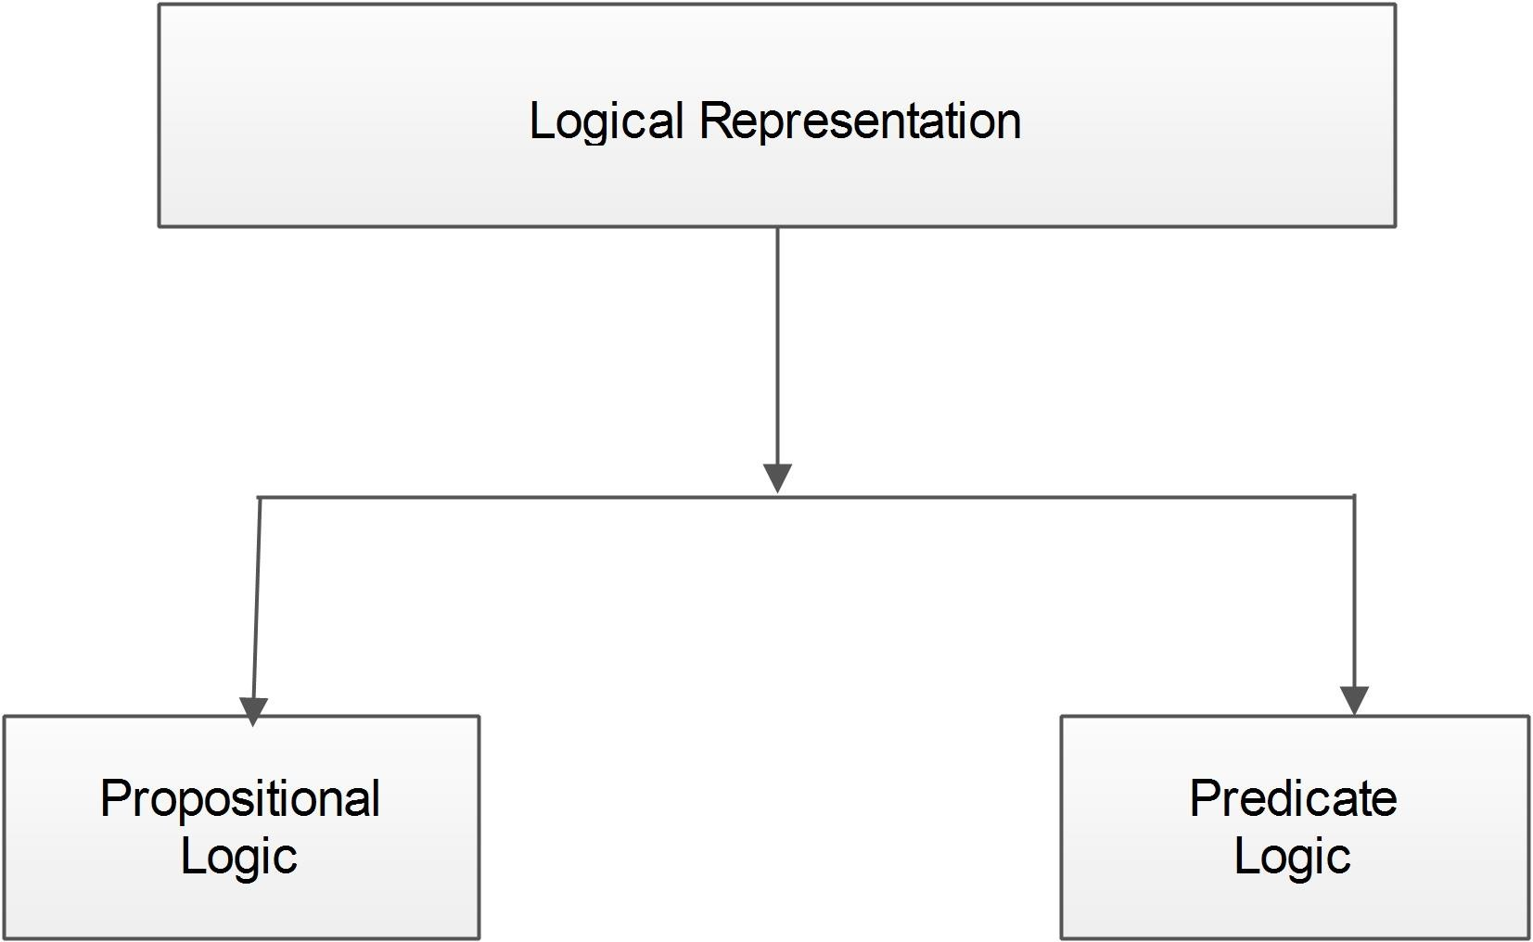

Slide 16
Propositional logic
Propositional/Boolean logic is the simplest form of logical representation in
which all the statements are represented by propositions.
A proposition is a declarative statement which is either true or false.
It is a technique of knowledge representation in logical and mathematical form.
Propositional logic consists of an object, relations or function, and logical
connectives/logical operators.
For example:
Sun rises from East (True) 7 is a prime number (True) 2+2 = 5 (False)

Slide 17
A proposition formula which is always true is called tautology, and it is also
called a valid sentence.
A proposition formula which is always false is called Contradiction.
Statements which are questions, commands, or opinions are not propositions such as "Where is Ram?", "How do you do?", "What is your name?", are not propositions.

Slide 18
It consists of precisely defined syntax and semantics which supports the sound
inference. Each sentence can be translated into logics using syntax and semantics.
Syntax:
Syntaxes are the rules using which we can construct legal sentences in the
logic.
It determines which symbol we can use in knowledge representation.
How to write those symbols.
Semantics:
Semantics are the rules by which we can interpret the sentence in the logic.
Semantic also involves assigning a meaning to each sentence.

Slide 19
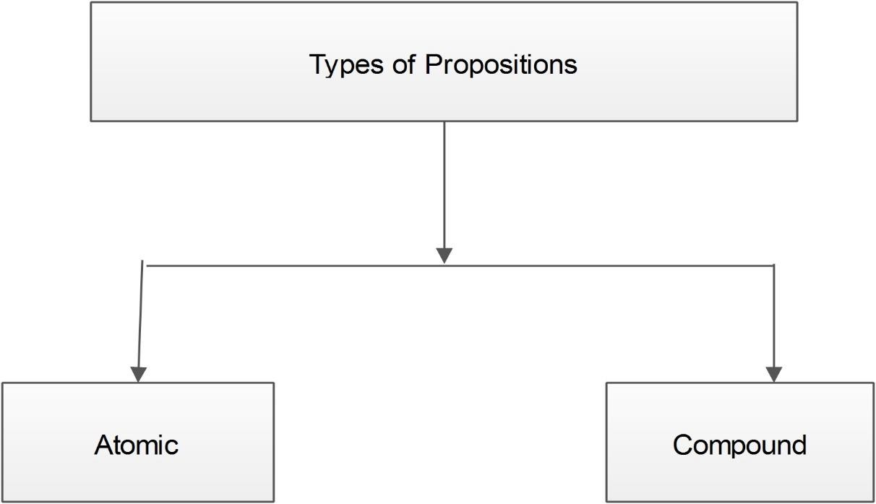
Atomic: These are the simple propositions consisting of single proposition symbol. For example 1+1 = 2 is an atomic proposition.
Compound/complex/composite: These are constructed by combining atomic propositions, using parenthesis and logical connectives. For example: (It is not raining today in Patiala)

Slide 20
Logical Connectives
Negation: A sentence such as ¬ P is called negation of P. A literal can be either Positive literal or negative literal. For example: Today is not holiday can be represented as ¬ P , where P: Today is holiday.
Conjunction: A sentence which has 𝖠 connective such as, P 𝖠 Q is called a conjunction. For example: Ramu eats fries, and Aman drinks soda.
Disjunction: A sentence which has ∨ connective, such as P ∨ Q. is called disjunction, where P and Q are the propositions. For example- The clock is slow or the time is correct can be represented as P ∨ Q.
Implication: A sentence such as P → Q, is called an implication. Implications are also known as if-then rule. For example: If there is a rain then the streets are wet.
Biconditional: A sentence such as P⇔ Q is a Biconditional sentence, For example If I am breathing, then I am alive

Slide 21
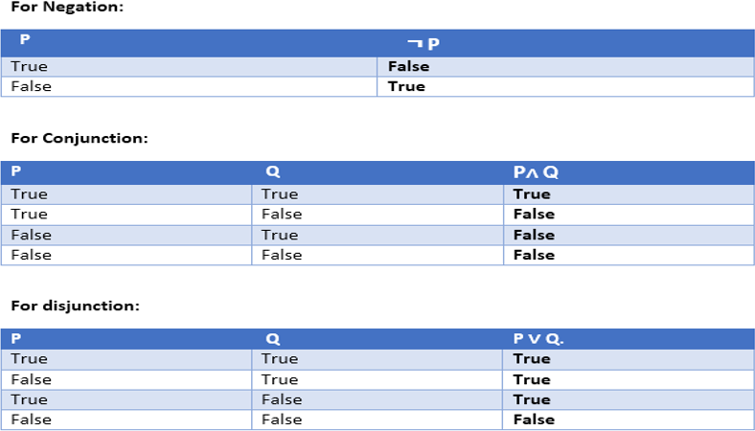
Truth Tables of Logical Connectors

Slide 22
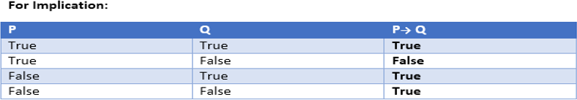
P->Q = Not P + Q
If you get an A+, then your father will give you a gift."
The statement will be true if your father keep his promise and false if he does n't.
Suppose it's true that you get an A+ and it's true that your father give you a gift. Since he
kept his promise, the implication is true. This corresponds to the first row in the table.
Suppose it's true that you get an A+ but it's false that your father give you a gift. Since he didn't keep his promise, the implication is false. This corresponds to the second row in the table.
What if it's false that you get an A+? Whether or not your father give you a gift, he has n't broken his promise. Thus, the implication can't be false, so (since this is a two-valued logic) it must be true. This explains the last two rows of the table.

Slide 23
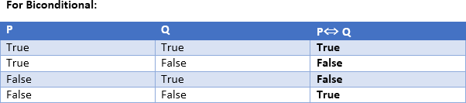
Note: We can create truth table for more than three propositions

Slide 24
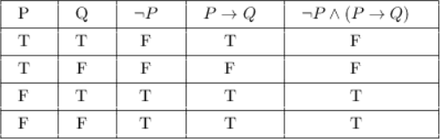
Construct a truth table for ¬ P 𝖠(P →Q)

Slide 25
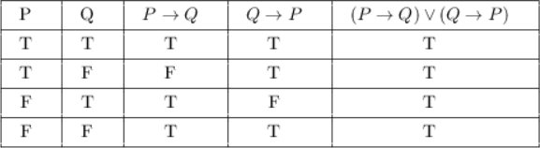
Show that (P →Q) V (Q →P) is a tautology.

Slide 26
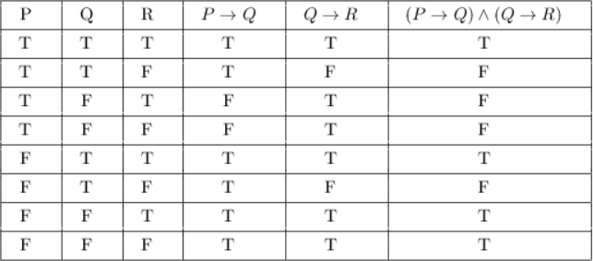
Truth table for (P →Q) 𝖠 (Q →R)

Slide 27
Examples
It is hot
It is humid
It is raining
Write down the proposition logic for
If it is humid then it is hot
If it is hot and humid then it is not raining
Take A= It is hot. B = It is humid. C= It is raining.
1. B → A
2. (A 𝖠 B) → ¬ C

Slide 28
P: Good mobile phones are not cheap Q: Cheap mobile phones are not good
L: P implies Q M: Q implies P
N: P is equivalent to Q
Which one of the following about L, M, and N is CORRECT?
Only L is TRUE.
Only M is TRUE.
Only N is TRUE.
L, M and N are TRUE
Truth Table
Let a and b be two proposition a: Good Mobile phones.
b: Cheap Mobile Phones.
a | b | ~a | ~b | P | Q
T | T | F | F | F | F
T | F | F | T | T | T
F | T | T | F | T | T
F | F | T | T | T | T
P and Q can be written in logic as P: a → ~b
Q: b → ~a.
It clearly shows P and Q are equivalent. so option D is Correct

Slide 29
Predicate Logic/First Order Logic
In Propositional Logic(PL), we can represent statements/facts which are either true
or false.
PL is not sufficient to represent the complex sentences or natural language
statements. The propositional logic has very limited expressive power.
For example we cannot represent following sentences using PL logic.
"Some employees are hard workers“
or
“All boys like cricket."

Slide 30
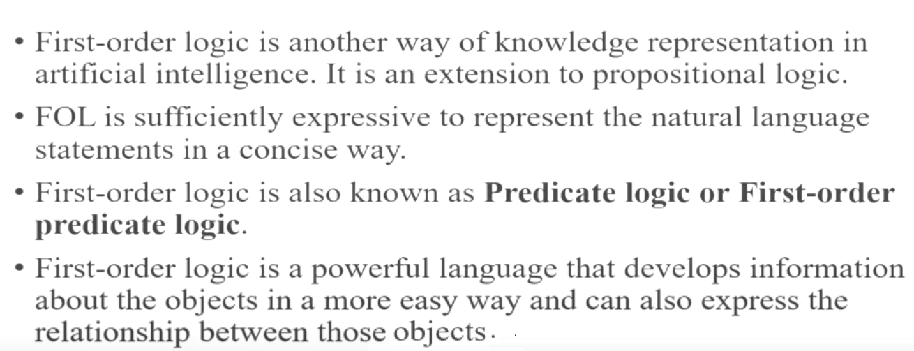
Predicate Logic/First Order Logic

Slide 31
First-order logic does not only assume that the world contains facts like
propositional logic but also assumes the following things in the world:
Objects: A, B, people, numbers, colors etc.
Relations: It can be unary relation such as: red, round, is adjacent, or n-any
relation such as: the sister of, brother of, has color, comes between
Function: Father of, best friend, third inning of, end of, ......

Slide 32
Basic Elements of First-order logic
Constant | 1, 2, A, John, Mumbai, cat,....
Variables | x, y, z, a, b,....
Predicates | Brother, Father, >,....
Function | sqrt, LeftLegOf, ....
Connectives | 𝖠, ∨, ¬, ⇒, ⇔
Equality | ==
Quantifier | ∀, ∃

Slide 33
First-order logic statements can be divided into two parts:
Subject: Subject is the main part of the statement.
Predicate: A predicate can be defined as a relation, which binds two atoms
together in a statement.
For example:
1. Ram is a batsman
Here Ram is Subject and is a batsman, is Predicate.
2. M is an Integer
Here M is Subject and is a integer, is Predicate

Slide 34
Atomic sentences:
Atomic sentences are the most basic sentences of first-order logic. These sentences are formed from a predicate symbol followed by a parenthesis with a sequence of terms.
We can represent atomic sentences as Predicate (term1, term2, ......, term n).
Example:
Ram and Shyam are brothers: => Brothers(Ram, Shyam).
Chinky is a cat => cat(Chinky)
Complex Sentences:
Complex sentences are made by combining atomic sentences using connectives.

Slide 35
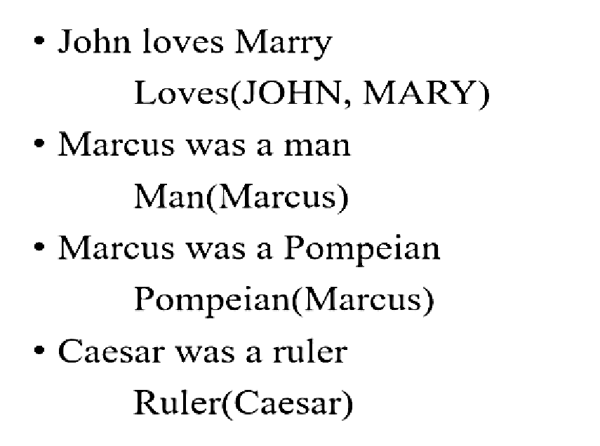

Slide 36
Quantifiers in First-order logic:
Universal Quantifier, (for all, everyone, everything)
The main connective for universal quantifier ∀ is implication →.
Existential quantifier, (for some, at least one).
The main connective for existential quantifier ∃ is and 𝖠.
If there is a statement: All man play cricket.
It can be converted into FOL as
∀x : man(x) → play (x, cricket).
Also if we have another statement- Some boys are intelligent.
∃x: boys(x) 𝖠 intelligent(x)

Slide 37
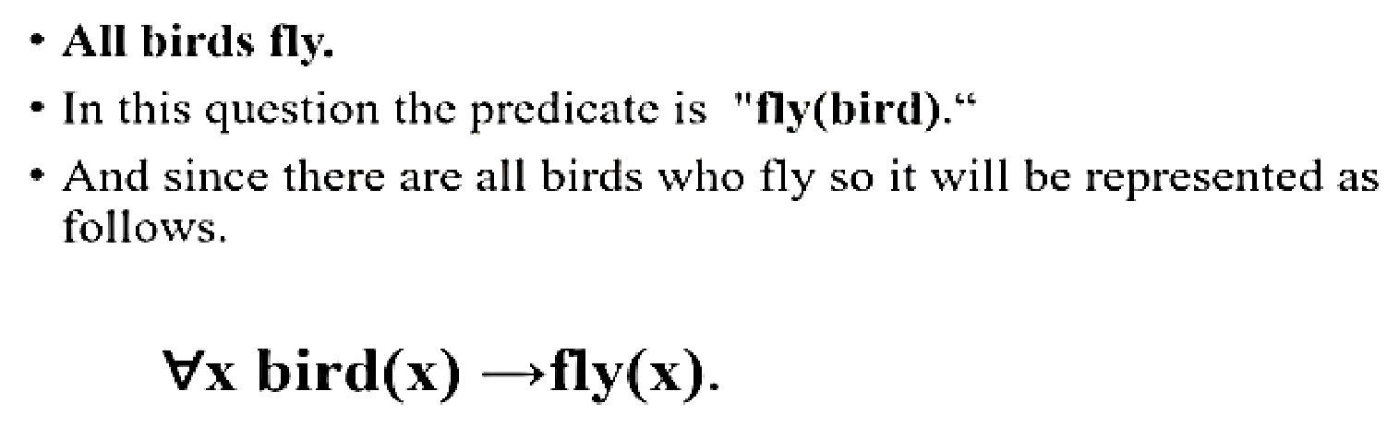

Slide 38
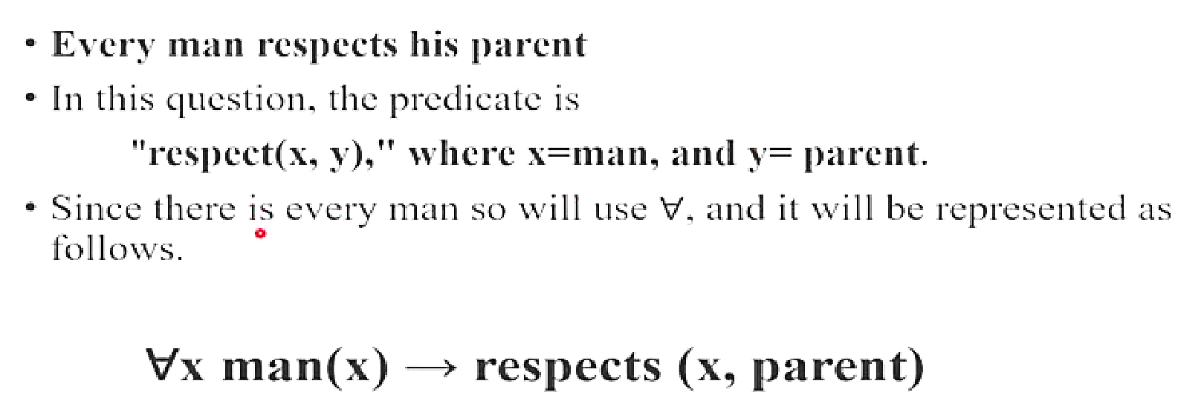

Slide 39
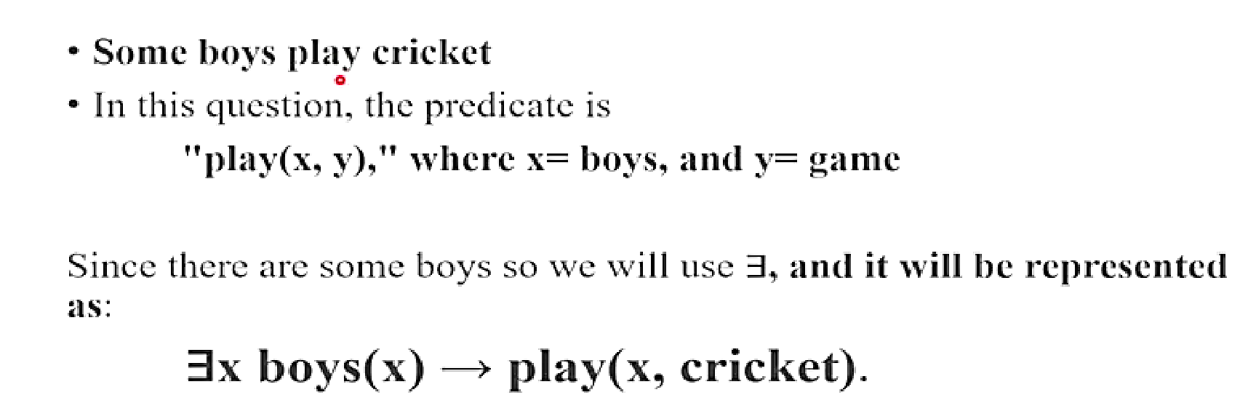

Slide 40
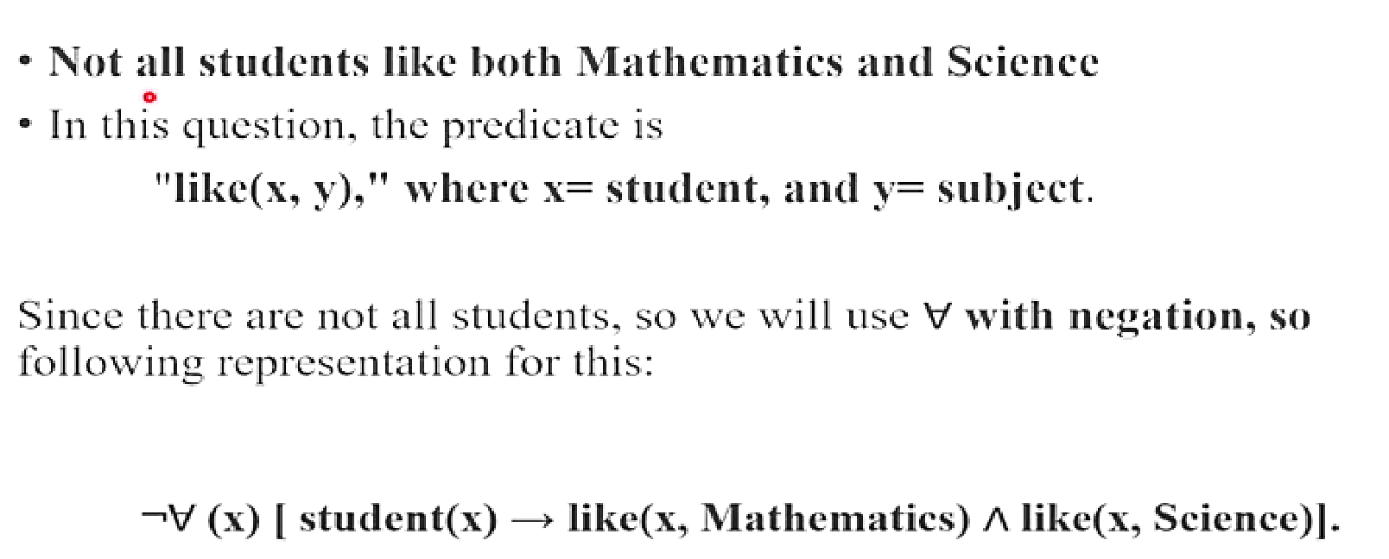

Slide 41
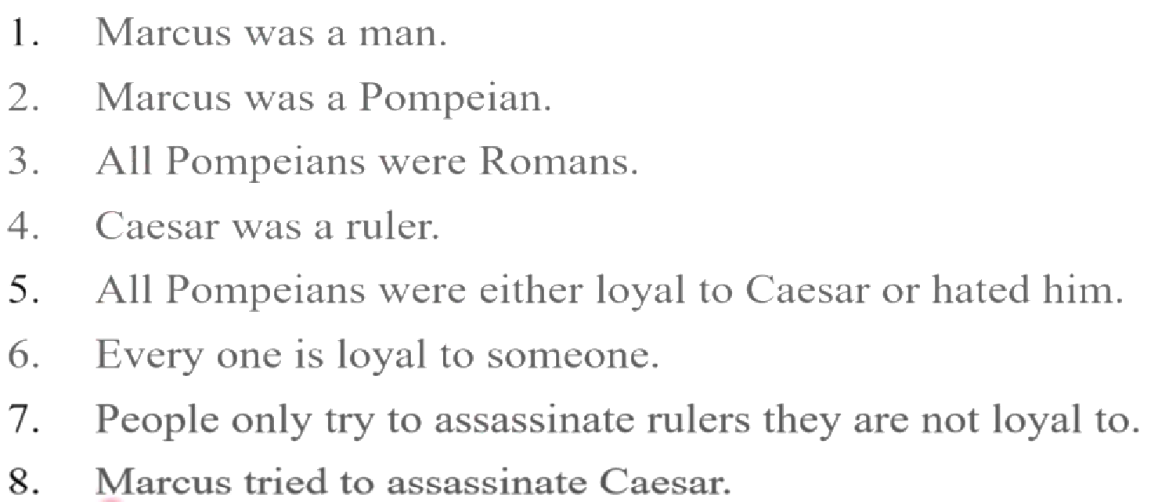

Slide 42
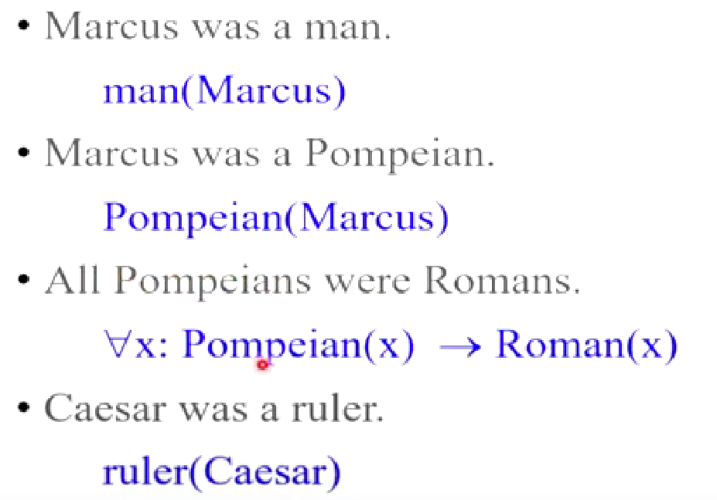

Slide 43
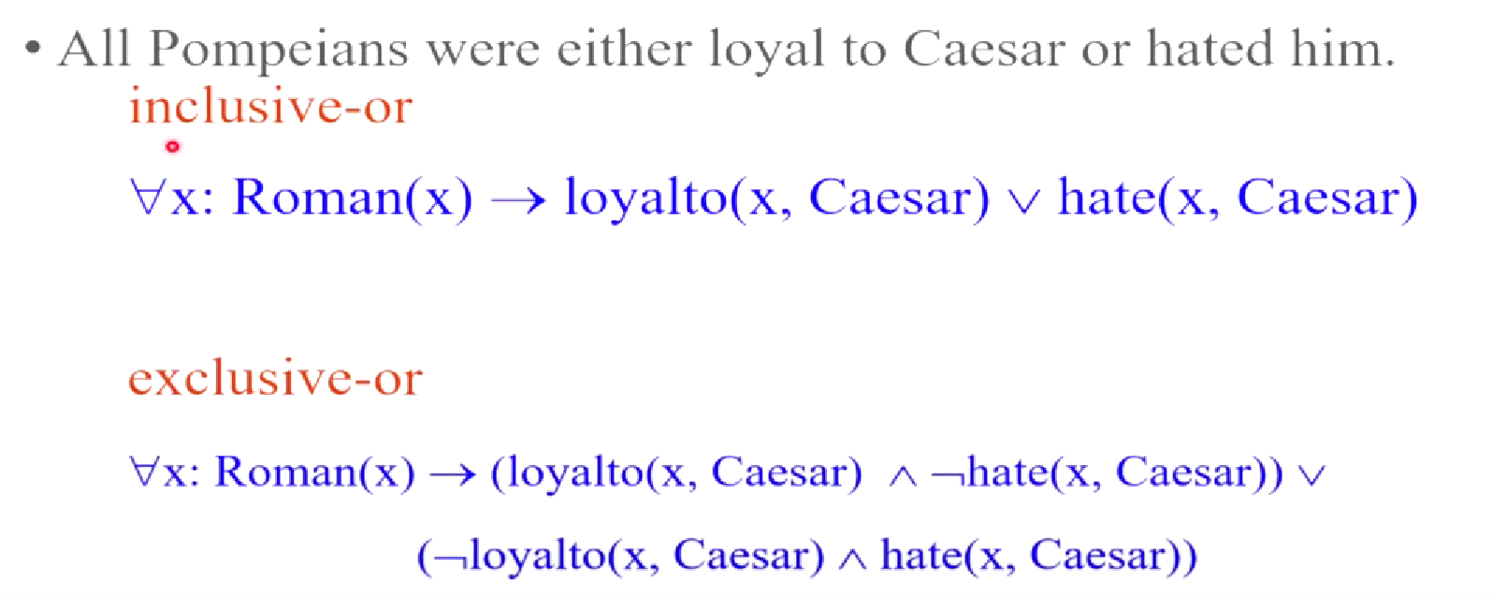
A eX-OR B = A’B + AB’

Slide 44
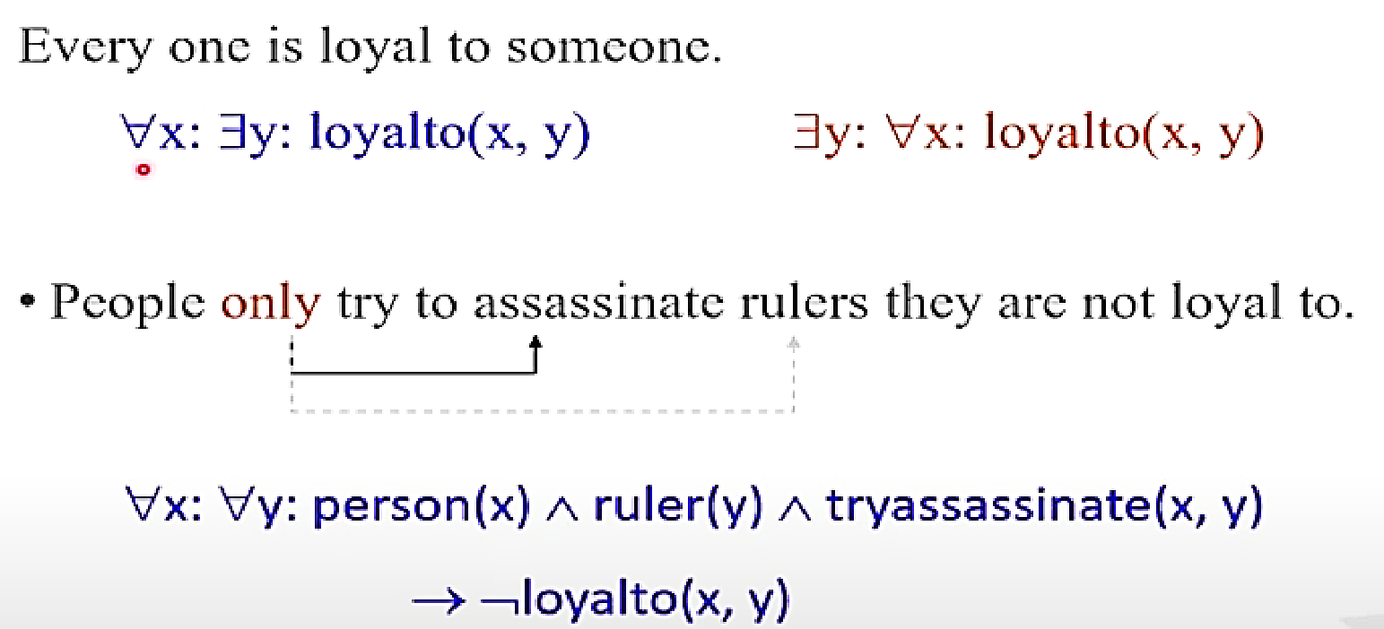

Slide 45
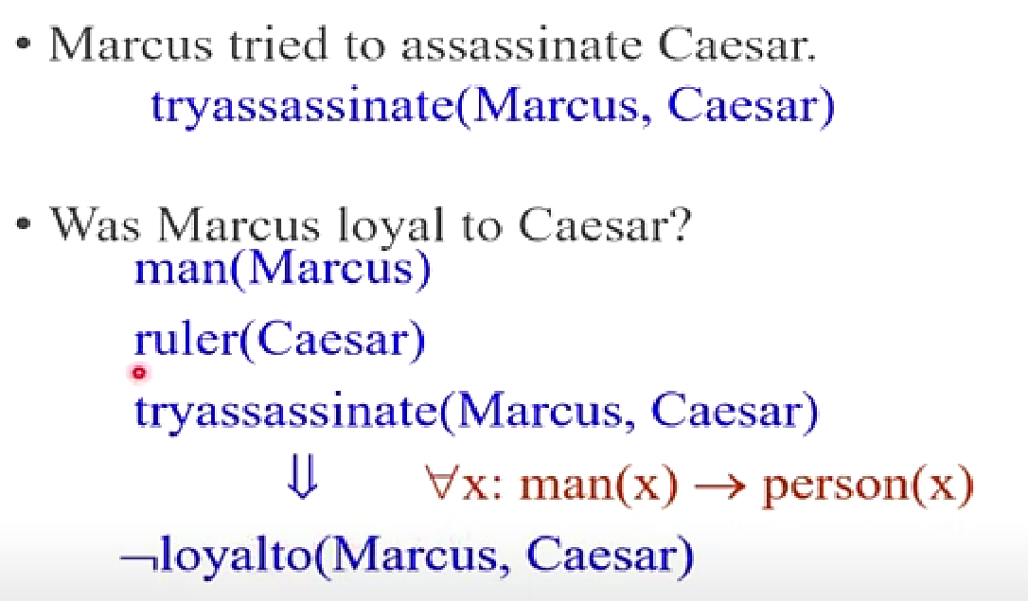

Slide 46
Example 1: Every house is a physical object
∀x: house(x) → physical_object(x)
where house and physical_object are unary predicate symbols.
Example 2: Some physical objects are houses
∃x: physical_object(x) 𝖠 house(x)
Example 3: Every house has an owner
∀x: house(x) → ∃y.owns(y, x)
here owns is a binary predicate symbol.

Slide 47
Example 4: “Everybody owns a house” is translated as
∀x.∃y.(owns(x, y) 𝖠 house(y))
Example 5: “Ram owns a house” is translated as
∃x.(owns(Ram, x) 𝖠 house(x))
where Ram is an individual constant symbol.

Slide 48
Example 6: “Ram does not own a house” is translated as
¬∃x.(owns(Ram, x) 𝖠 house(x))
Example 7: “Somebody does not own a house” is translated as
∃x.∀y.(owns(x, y) → ¬house(y))

Slide 49
Advantages | Disadvantages
Logical representation help to perform logical reasoning | Logical representations have some restrictions and are challenging to work with.
This representation is the basis for the programming languages | This technique may not be very natural and inference may not be very efficient.

